Slide 1
Terrestrial Microwave Link
RITU KUMARI
SACHIN THATAL
SALIM SHRESTHA
SARSWOTI ROKAYA

Slide 2
Outline
Terrestrial microwave links:
Block diagram
Working principle
Concept of Fresnel zone clearance

Slide 3
What is a Terrestrial Microwave Link?
A wireless communication system using microwave frequencies
Uses line-of-sight (LOS) propagation
Connects two fixed ground stations
Operates typically in the 1–30 GHz frequency band
Used to transmit high‑capacity voice, data, and video signals

Slide 4
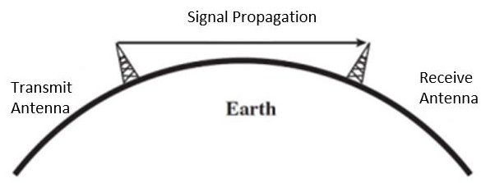
BLOCK DIAGRAM

Slide 5
Why Do We Need Terrestrial Microwave Links?
To establish reliable long-distance communication
To provide backhaul connectivity for telecom networks
Faster & cheaper deployment compared to fiber
Useful in remote or difficult terrains where cables are impractical
Supports high-bandwidth requirements for modern networks

Slide 6
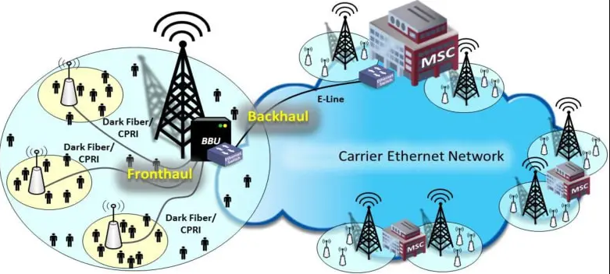
Your mobile phone connects to a nearby cell tower.
Backhaul connectivity = the network that carries data from towers to the main telecom infrastructure.

Slide 7
Applications
Telecom backbone transmission
Internet Service Provider (ISP) backhaul links
Broadcasting (TV, radio)
Military and defense secure communication
Emergency and disaster‑recovery communication

Slide 8
Merits (Advantages)
High bandwidth capability
Quick installation and deployment
Cost-effective over long distances
Reliable and stable link quality
Minimal maintenance required
Flexible network planning

Slide 9
Demerits (Disadvantages)
Requires clear line-of-sight
Signal susceptible to physical obstructions
Performance affected by weather (rain, storms)
Installation requires careful alignment
Licensing may be expensive

Slide 10
Limitations
Earth’s curvature restricts distance (usually 40–60 km per hop)
Atmospheric absorption at higher frequencies
Interference from nearby microwave systems
Limited frequency spectrum availability
Towers or elevated structures required

Slide 11
Working Principle of Terrestrial Microwave Link
Uses Line-of-Sight (LOS) microwave propagation between two stations
Transmitter converts data into microwave signal and radiates it via antenna
Signal travels through atmosphere with minimal attenuation
Receiver antenna captures the signal and converts it back to electrical form
Highly directional antennas ensure focused transmission with minimal interference

Slide 12
Concept of Fresnel Zone Clearance
Fresnel zones define elliptical regions around the LOS path
Obstacles inside these zones cause diffraction and signal loss
First Fresnel Zone must be at least 60% clear for optimal performance
Larger link distances require greater clearance due to Earth curvature
Ensuring Fresnel clearance reduces fading and increases link reliability

Slide 13
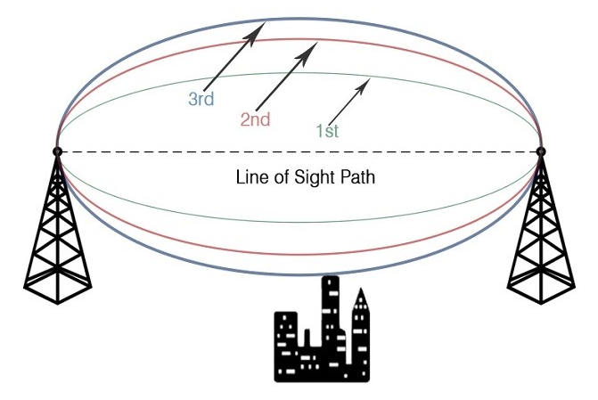
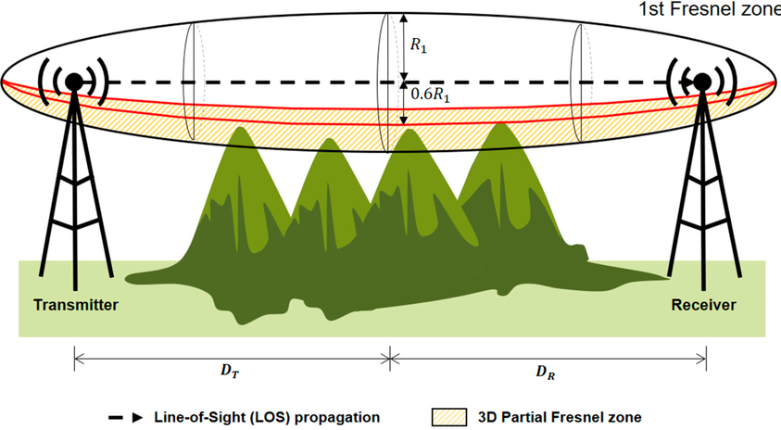
A Fresnel zone is a series of concentric, elliptical regions of space between a transmitter and a receiver.

Slide 14
THANK YOU

